Slide 1
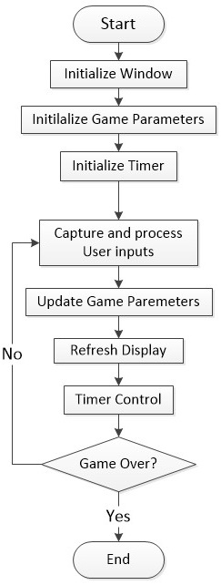
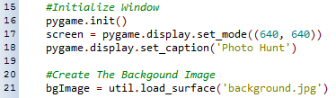
Initialize the gaming window
Prepare the background image

Slide 2
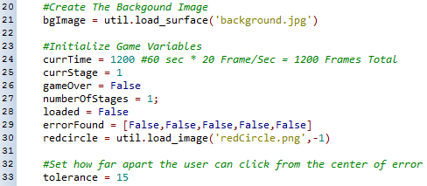
Initialize the time
Initialize the stage
Set to not game over
Initialize the gaming window
Initialize the game parameters: found and loaded
Initialize the image and tolerance of the red circle

Slide 3


Slide 4
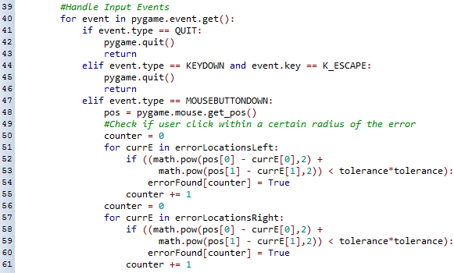
Capture user quits
Capture mouse click
Get mouse position
Process mouse position to check if a correct difference is click.

Slide 5
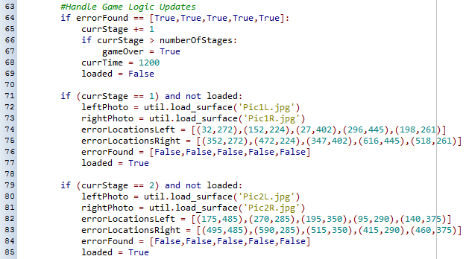
Update Game Parameters – Next Stage
Update game parameters
Reload images and coordinates of that stage

Slide 6
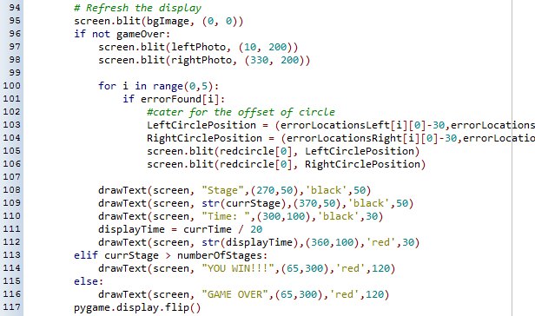
Refresh background image
If clear all stages, display “You Win”
Refresh left and right images
If timer runs out, display “Game Over”
Refresh the red circles
Refresh stage number and timing

Slide 7


Decrease timer
Game over if time is up
Control the framerate

Slide 8
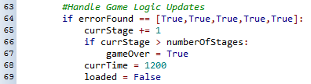


Game over if clear all stages
Game over if time runs out
Check the type of game over and display accordingly

